Slide 1
Business Intelligence
Discover how Business Intelligence can equip your organization with the tools and insights needed to make strategic, data-driven decisions and gain a competitive edge in the market.

Slide 2
BI Techniques
Business Intelligence (BI) techniques help organizations by transforming raw data into actionable insights that drive informed decision-making.
Online Analytical Processing (OLAP)
Data Visualization
Data Mining
Reporting
Analytics
Extraction-Transaction-Loading (ETL)
Statistical Analysis

Slide 3

Online Analytical Processing (OLAP)
Online Analytical Processing (OLAP) is an important business intelligence technique, that is used to solve analytical problems with different dimensions. A major benefit of using OLAP is that its multi-dimensional nature provides leniency for users to look at data issues from different views. By doing so, they can even identify hidden problems in the process. OLAP is mainly used to complete tasks like budgeting, CRM data analysis, and financial forecasting.

Slide 4

Data Visualization
Data is often stored in form of numbers that are put together as a matrix. But interpreting the matrix to make business decisions is a critical task. A commoner, or even an analyst, can find the progress of data when it is stored as a set. To untangle the knot, data visualization is used. Data visualizations help professionals look at data from more than one dimension and help them make informed decisions. Therefore, visualization of data in charts is an easy and convenient way to understand the stance.

Slide 5

Data Mining
Data mining is the process of analyzing large quantities of data to discover meaningful patterns and rules by automatic or semi-automatic means. In a corporate data warehouse, the amount of data stored is very huge. Finding the actual data that could drive business decisions is quite critical. Therefore, analysts use data mining techniques to unravel the hidden patterns and relationships in data. Knowledge discovery in databases is the whole process of using the database along with any required selection, processing, sub-sampling, choosing the proper way for data transformation.

Slide 6

Reporting
Reporting in business intelligence represents the whole process of designing, scheduling, generating the performance, sales, and saving the content. It helps companies to effectively gather and present information to stand by the management, planning, and decision-making process. Business leaders get to view the reports at daily, weekly, or monthly intervals as per their needs.

Slide 7
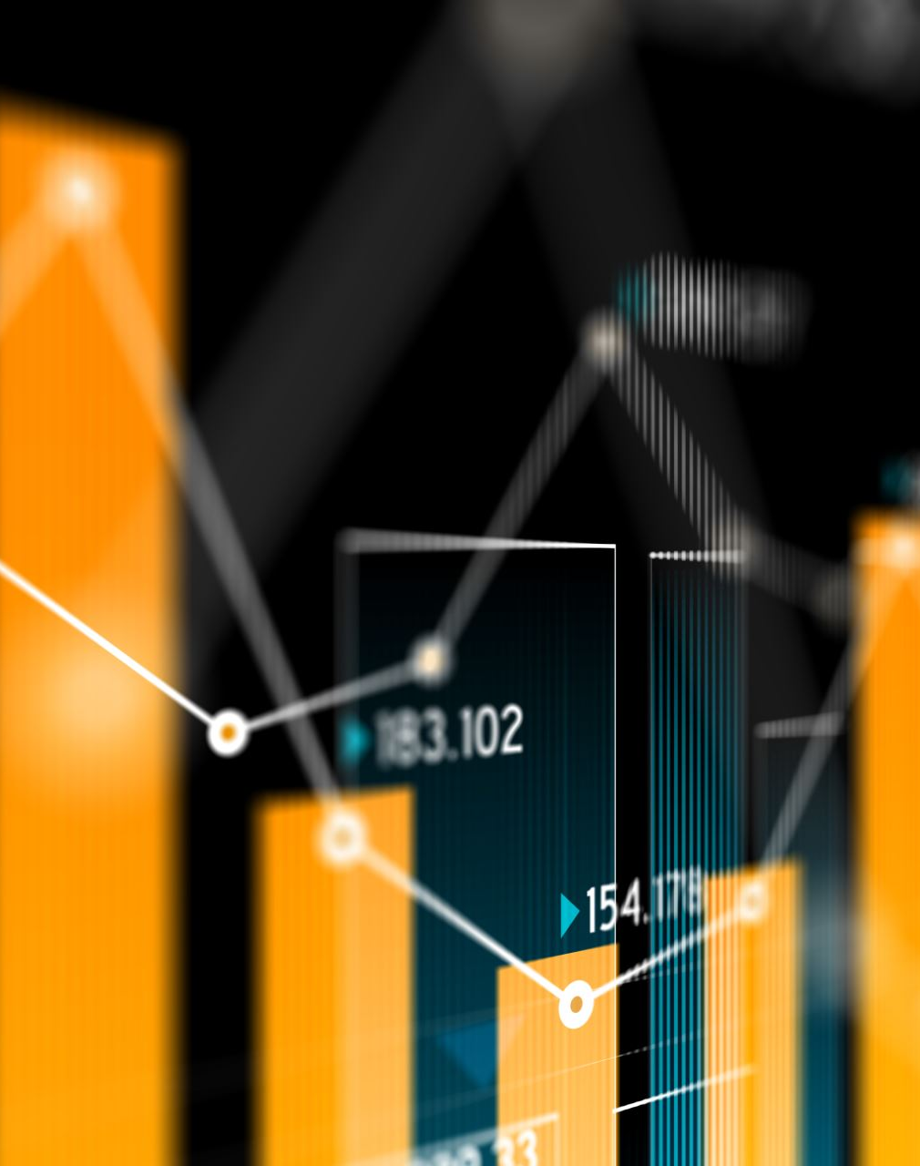
Analytics
Analytics in Business Intelligence defines the study of data to extract effective decisions and figure out the trends.
Analytics is famous among business companies as it lets analysts and business leaders deeply understand the data they have and drive value from it. Many business perspectives, from marketing to call centers to use analytics in different forms. For example, call centers leverage speech analytics to monitor customer sentiments and improve the way answers are presented.

Slide 8

Extraction-Transaction-Loading (ETL)
Extraction-Transaction-Loading (ETL) is a unique business intelligence technique that takes care of the overall data processing routine. It extracts data from storage, transforms it into the processor, and loads it into the business intelligence system. They are mainly used as a transaction tool that transforms data from various sources to data warehouses. ETL also moderates the data to address the need of the company. It improves the quality level by loading it into the end targets such as databases or data warehouses.

Slide 9

Statistical Analysis
Statistical analysis uses mathematical techniques to create the significance and reliability of observed relations. It also grasps the change of behavior in people that are visible in data with its distribution analysis and confidence intervals. Post data mining, analysts carry out statistical analysis to devise and get effective answers.

Slide 10
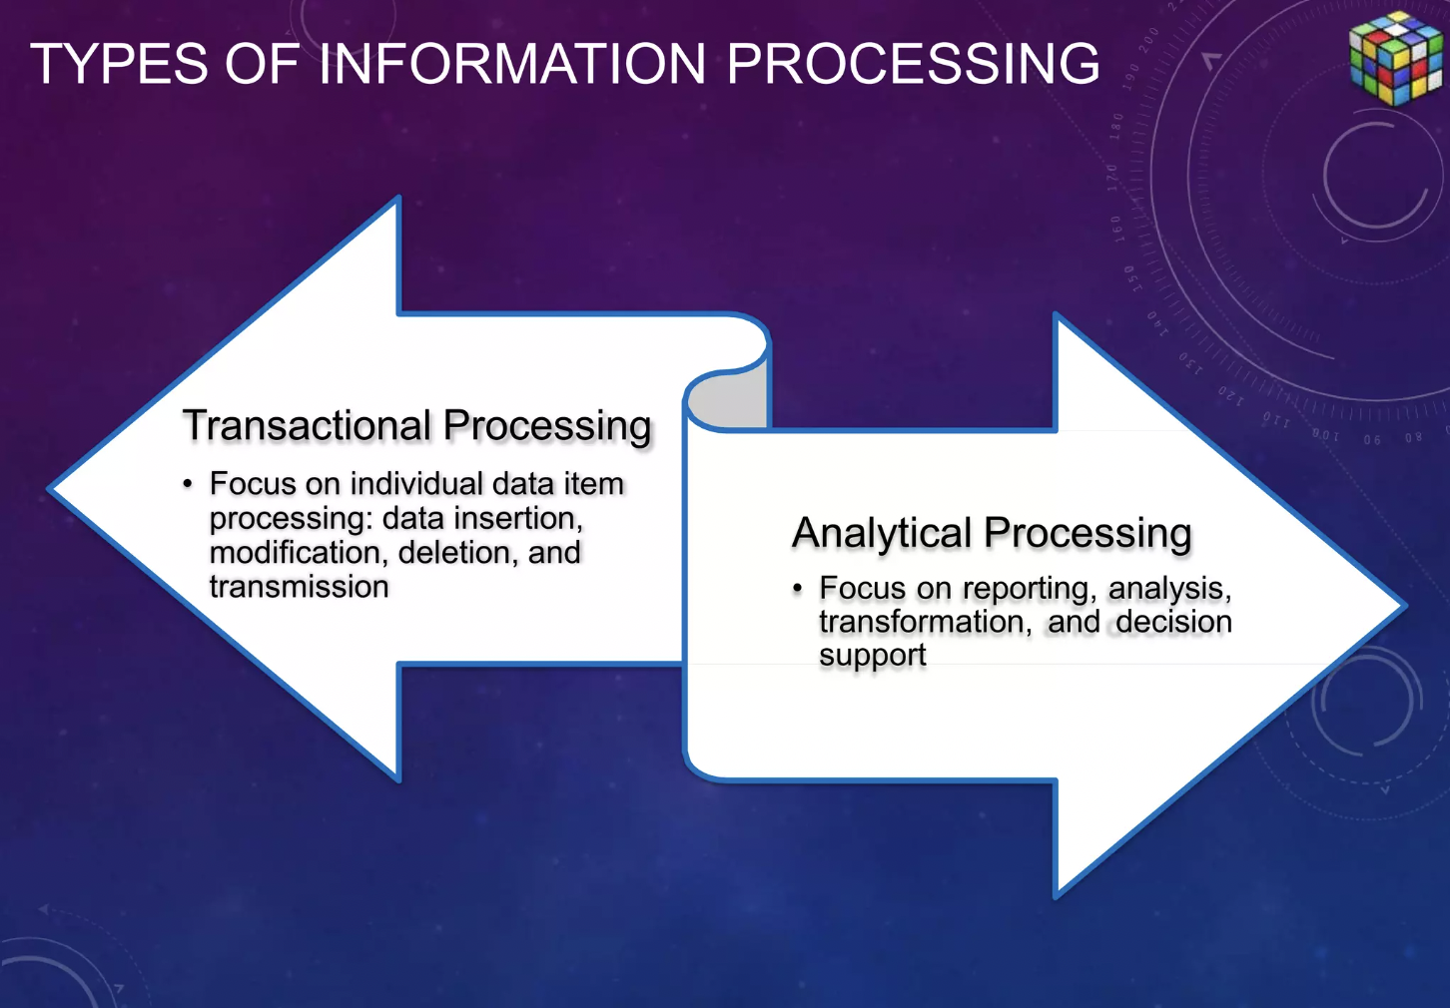

Slide 11
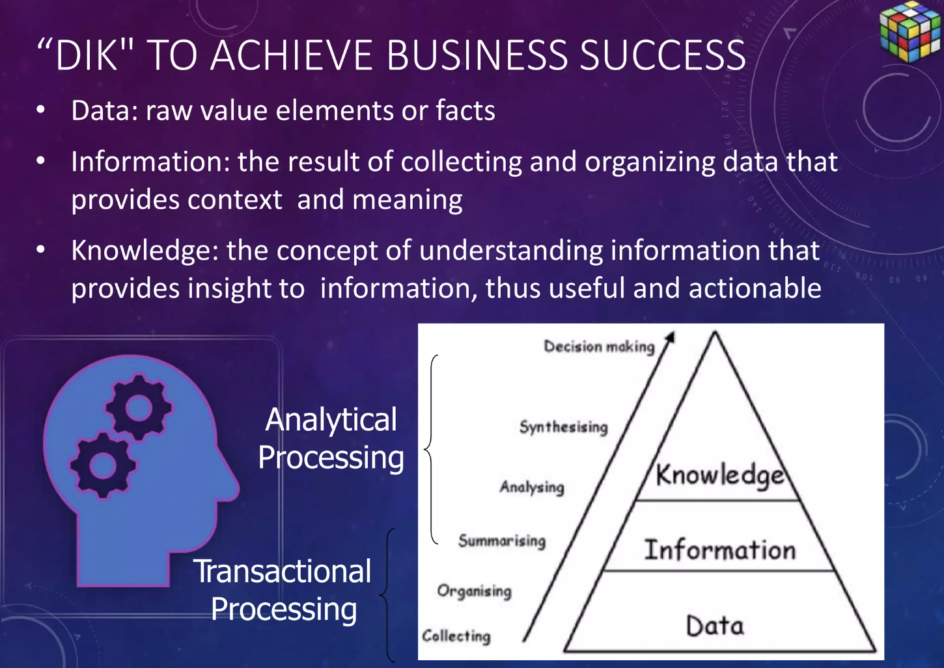

Slide 12
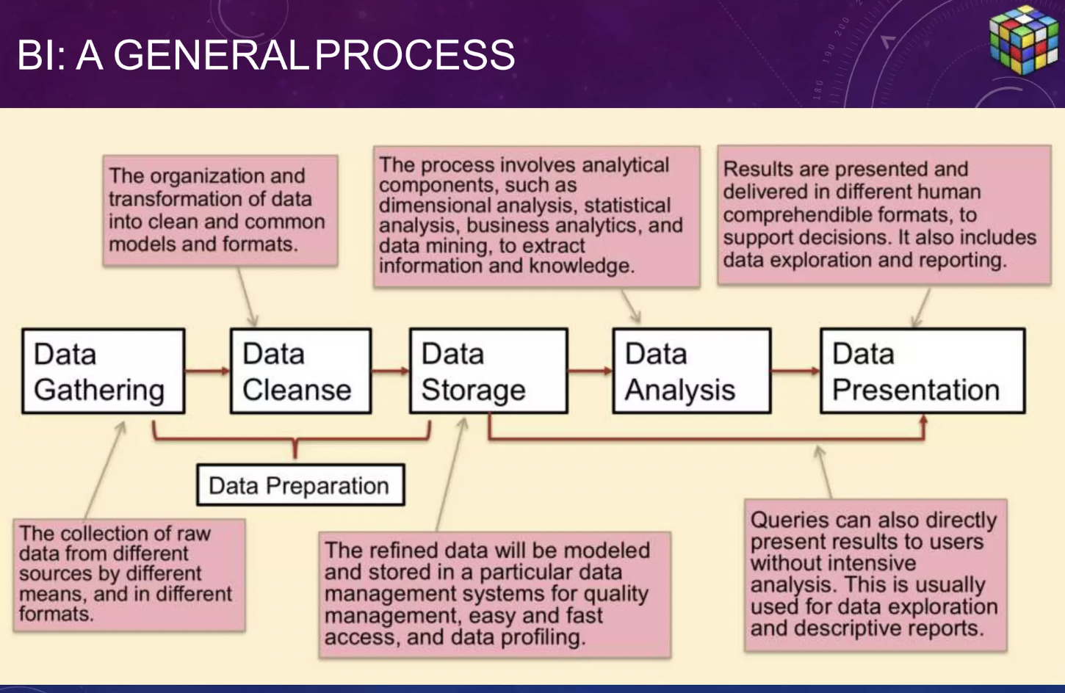

Slide 13
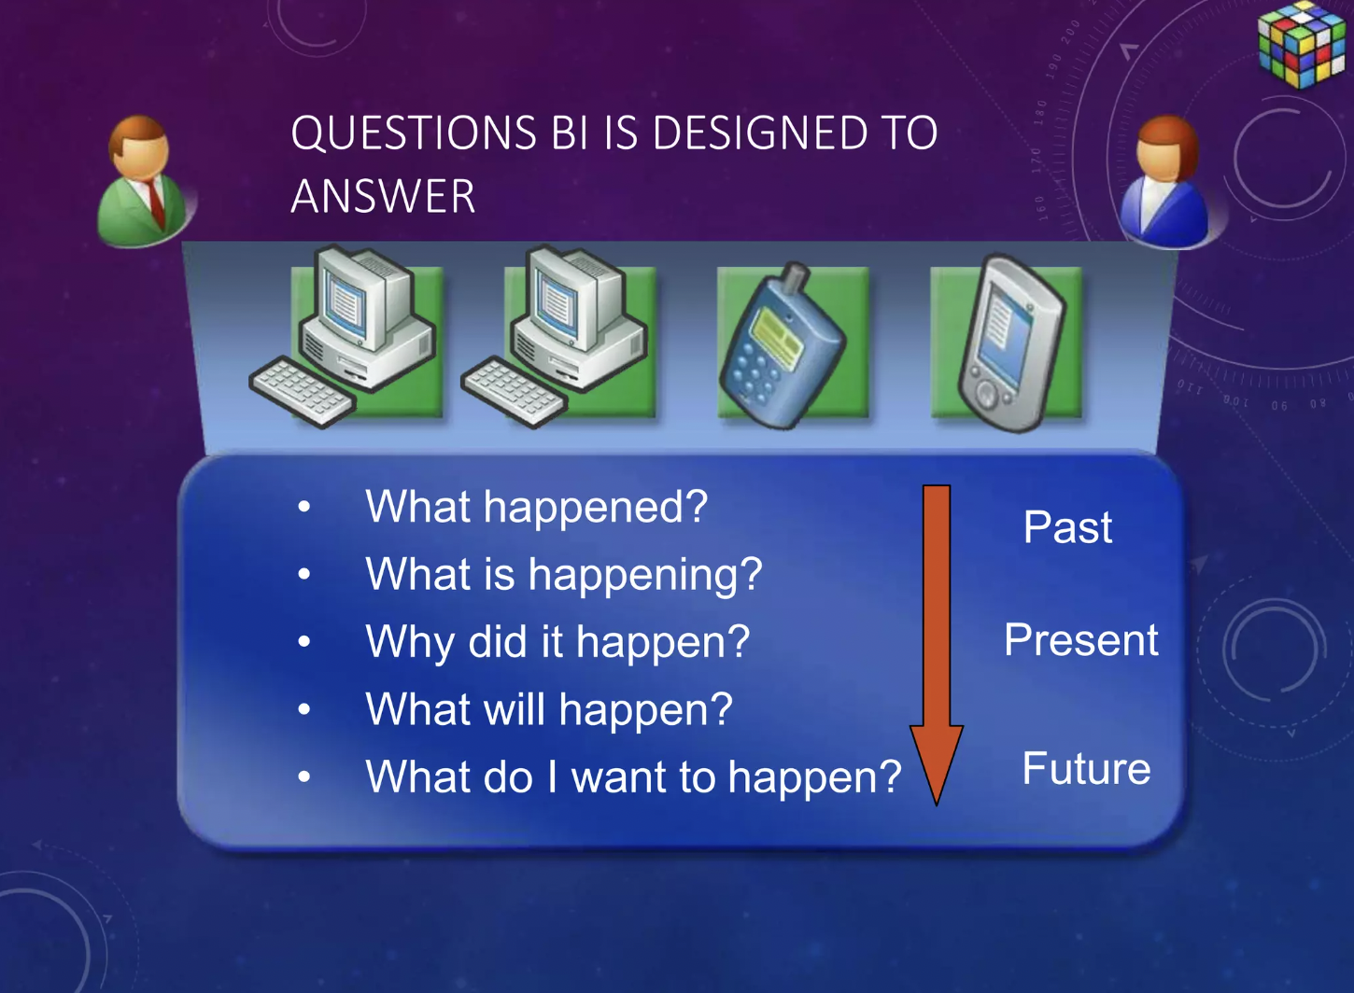

Slide 14

Levels of Analytical Processing
Descriptive analytics
Diagnostic analytics
Predictive analytics
Prescriptive analytics

Slide 15

Descriptive analytics
Descriptive (also known as observation and reporting) is the most basic level of analytics.
Many times, organizations find themselves spending most of their time in this level. Think about dashboards and why they exist: to build reports and present on what happened in the past. This is a vital step in the world of analytics and decision making, but it's really only the first step. It’s important to get beyond the initial observations and dive into insights, which is the second level of analytics.

Slide 16
Diagnostic analytics
Diagnostic analytics is where we get to the why. We move beyond an observation (like whether the chart is trending up or down) and get to the “what” that is making it happen.
Imagine going to a doctor where the only thing they do is look at you, make the observation that “oh, yeah, you look sick,” and then leave the room. That's not going to do much for your health. We need to be able to understand what is causing the sickness. The doctor should make the observation, diagnose you and then give you a treatment plan to help you feel better. It’s the same thing with analytics: you make an observation, identify the descriptive analysis and move forward to the diagnosis.

Slide 17
Predictive analytics
Predictive analytics allows organizations to predict different decisions, test them for success, find areas of weakness in the business, make more predictions—and so forth. This flow allows organizations to see how the first three levels can work together.
Predictive analytics involves technologies like machine learning, algorithms, and artificial intelligence, which gives it power because this is where the data science comes in. Now, when we incorporate the importance of not just predicting, but using data science, statistics, and the third-level of analytics combined with the first two levels, organizations truly can see success with their data and analytical strategies.

Slide 18
Prescriptive analytics
Think of the first three levels of analytics: you have your description of what has happened, followed by diagnosing why, and then you end with predicting what will happen. Now, imagine you allow the data and analytics to inform you what action to take. That is powerful and why it matters for businesses.

Slide 19
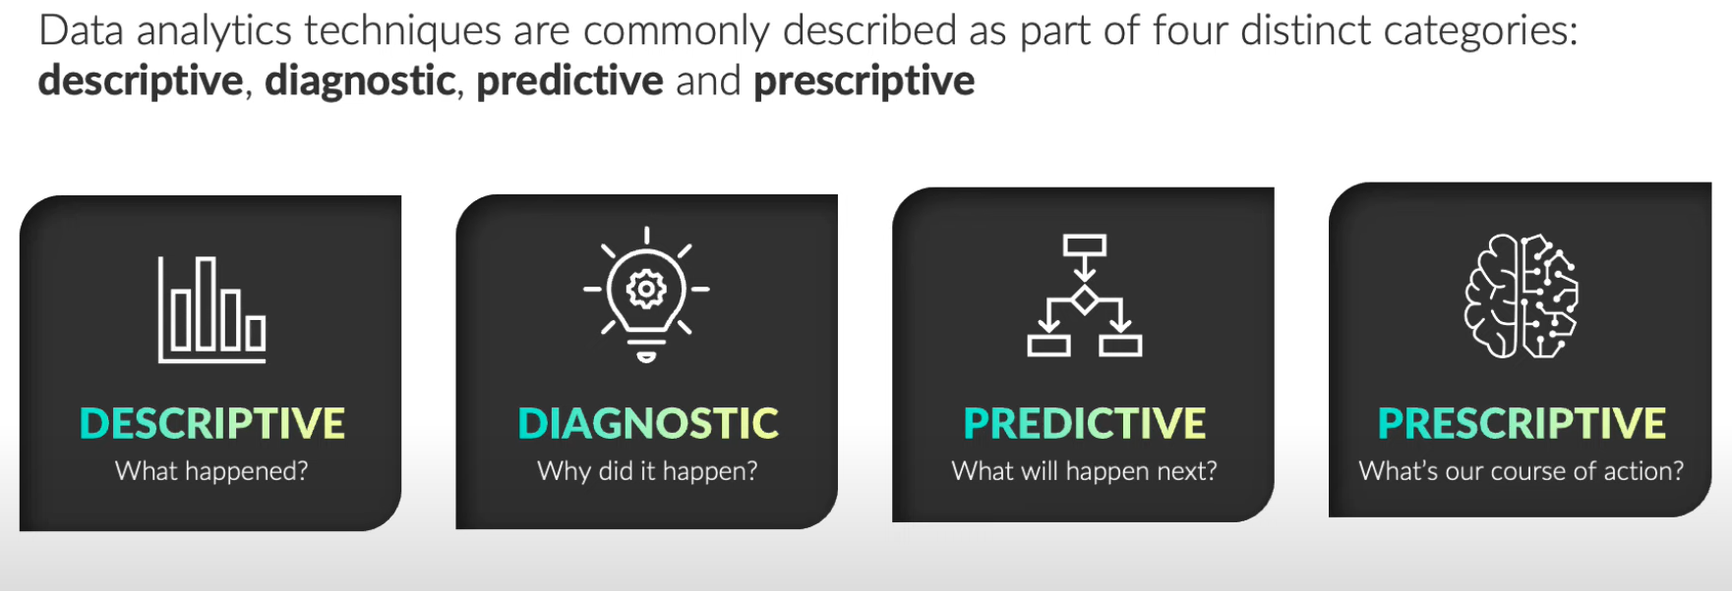
Conclusion

Slide 20
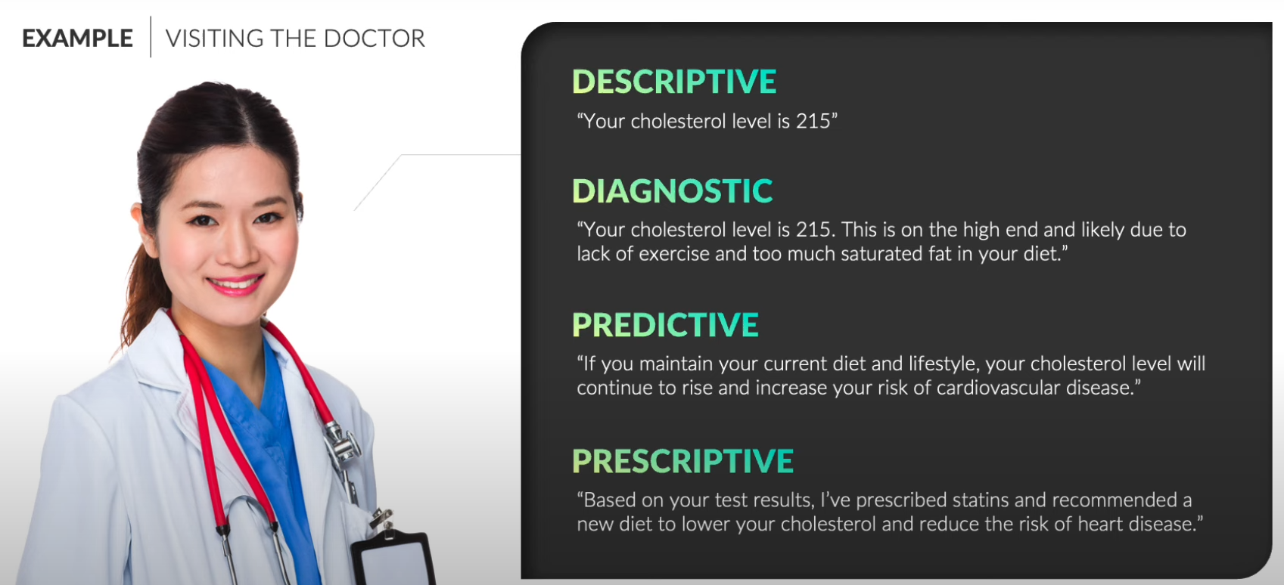
Example

